Slide 1
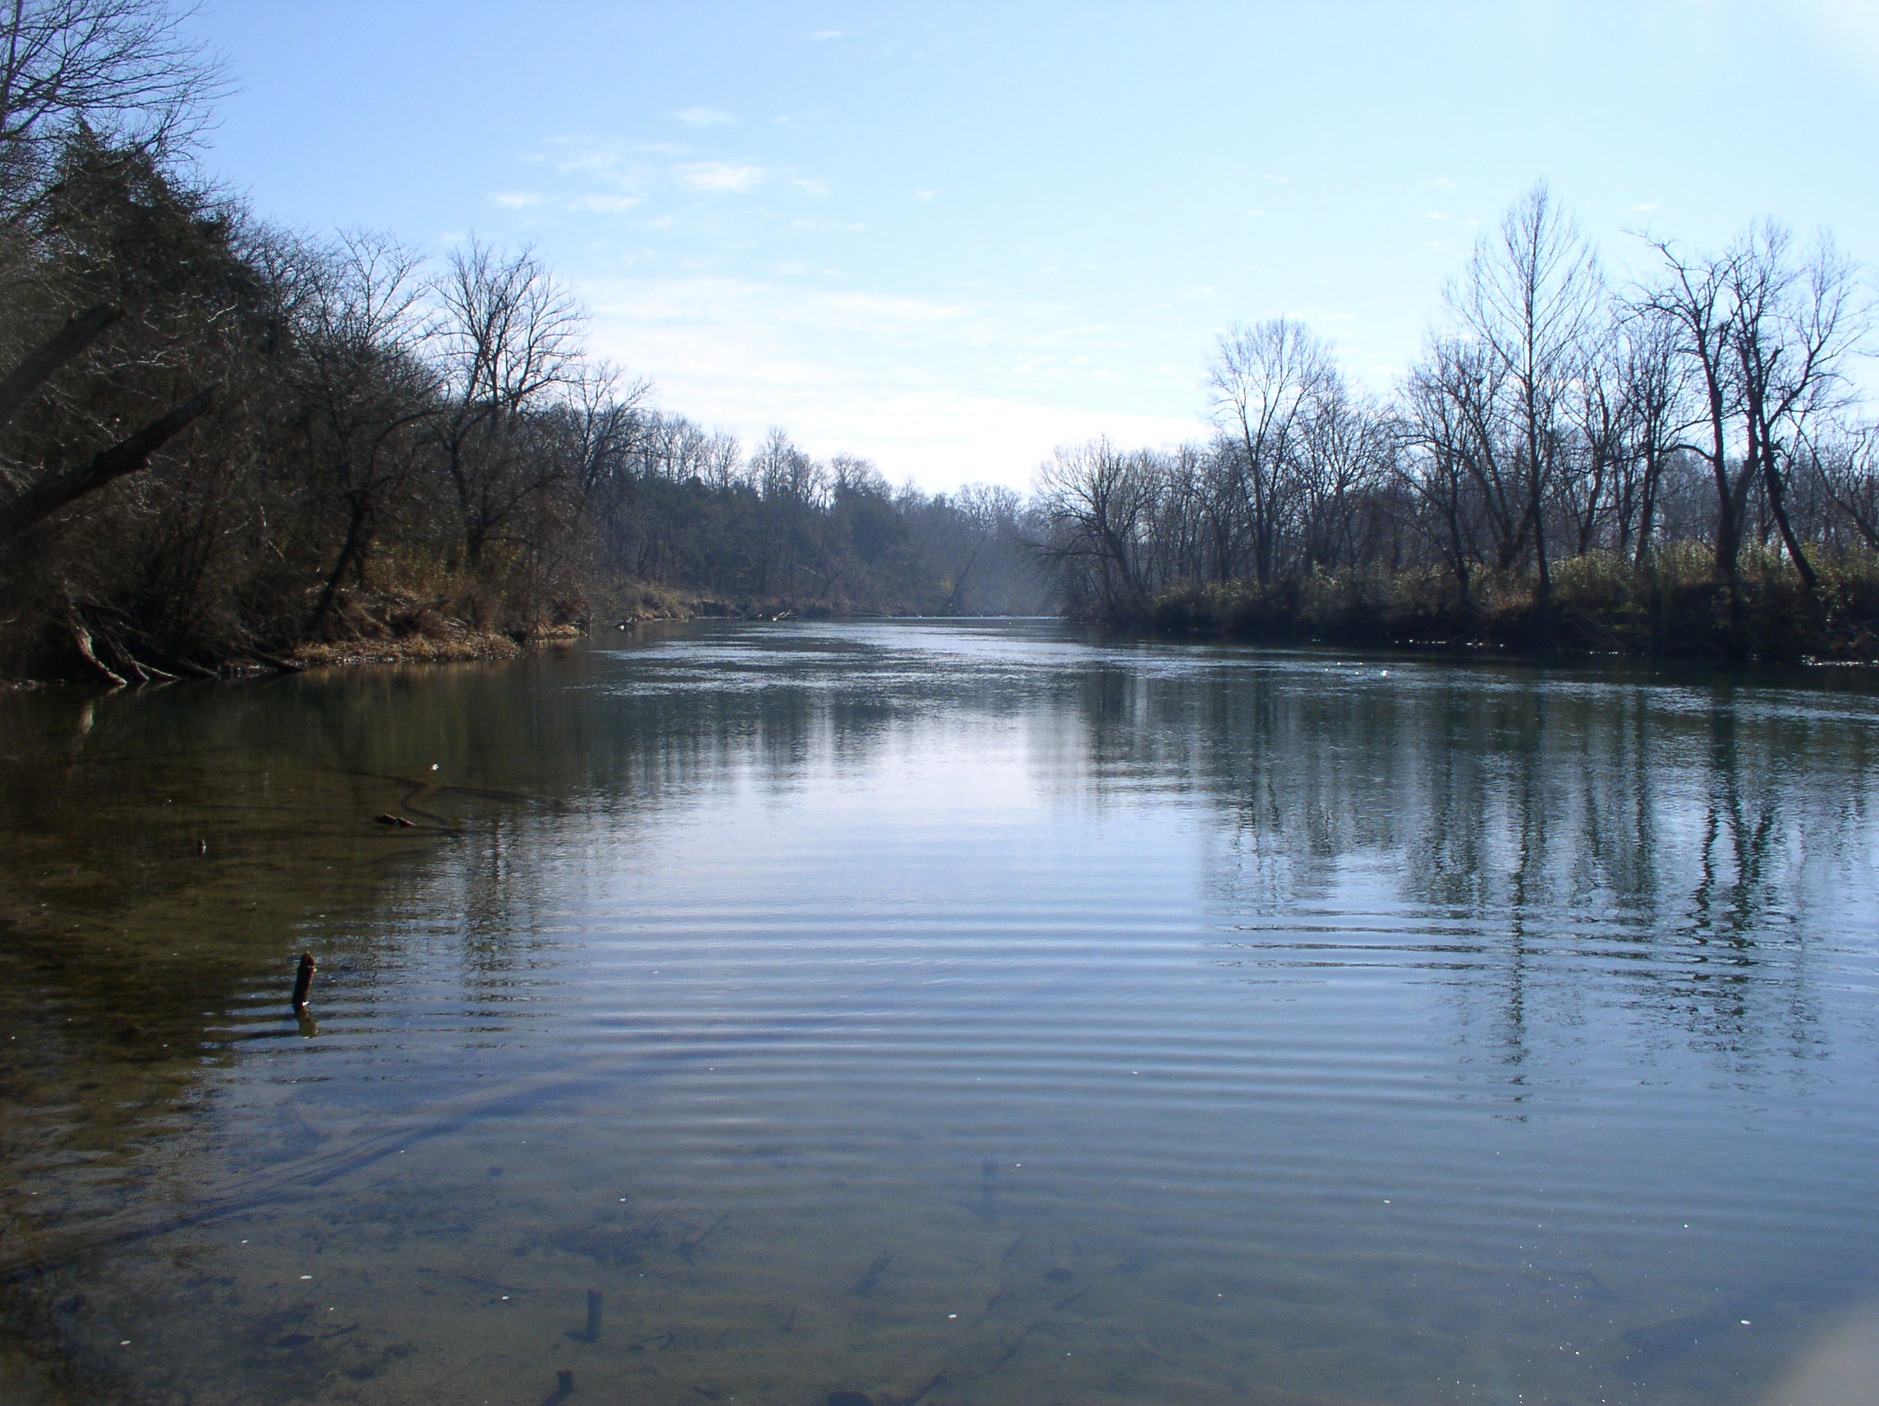
ELEVEN POINT WATERSHED COST SHARE PROJECT
ANRC, EPA, RCCD, NRCS
RANDOLPH COUNTY CONSERVATION DISTRICT

Slide 2
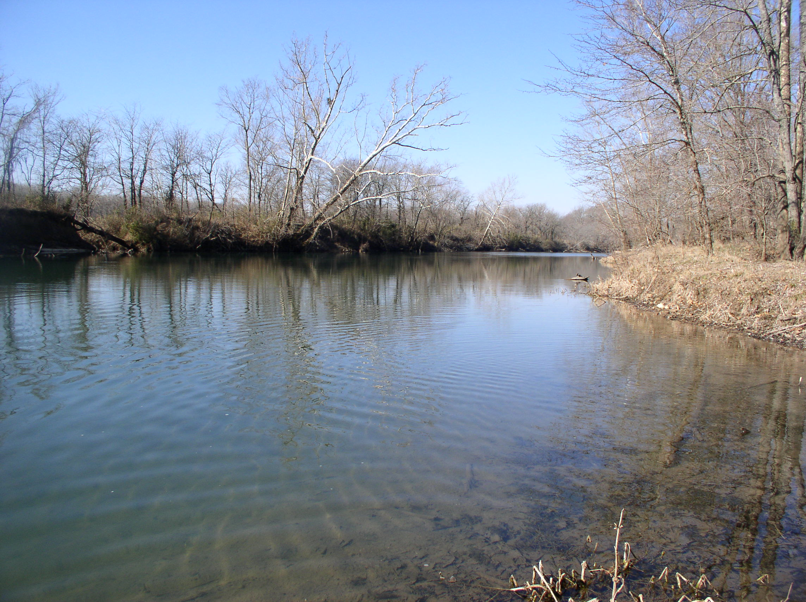
The Problem:
Listed on 303(d) list
Organic enrichment causing depleted oxygen levels.
Not sustaining the designated use for aquatic life because of low dissolved oxygen.
Agriculture activities within the watershed are thought to be the major source of nutrient runoff in the watershed.

Slide 3
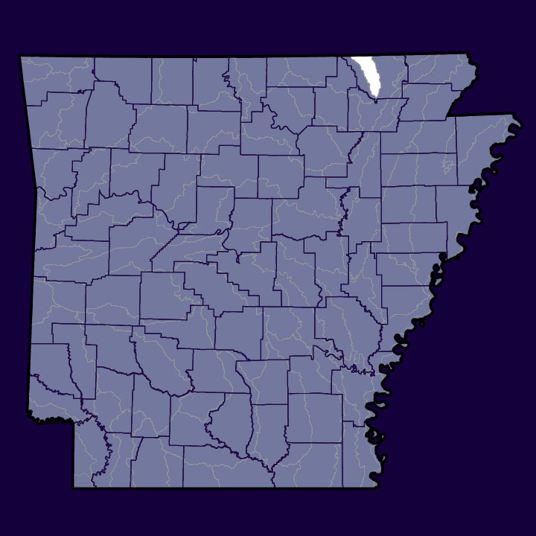
Eleven Point River Watershed
2006 Land Use
Arkansaswater.org
Forest: 61.7%
Grassland: 33.4%
Transitional: 4.0%
Water: 0.6%
Cropland: 0.5%
Suburban: 0.2%
Urban: 0.1%

Slide 4
Eleven Point River 319(h) Project
Project Management:
Randolph County Conservation District
Project Cost: Total ($328,460)
Federal ($169,500) State/Local($158,960)
$75,000 federal dollars made available to
landowners for up to 40% cost share

Slide 5
Eleven Point River 319(h) Project
Goal: Improve land in the watershed
Objective: Write 132 Conservation plans

Slide 6
Eleven Point River 319(h) Project
Project Tasks
Utilize Conservation District Board
Provide Technical Assistance
Provide Cost Share for BMP Implementation
Technology Transfer
Equipment Purchase
Reporting

Slide 7
Task 1
Steering Committee Responsibilities
R.C.C.D. will meet monthly for 3 years
Review all inventories and assessments done in the Watershed; set priorities for cost-share in the project area; and coordinate all activities of the project components
Review and approve all deliverables

Slide 8
Task 2
Technical Assistance
The District Technician will write 132 conservation plans over a 3 year period.
R.C.C.D. will make return visits as needed to the 132 farms planned to assist with conservation planning and BMP implementation.

Slide 9
Task 3
Cost Share 40%:
Based on 2009 EQIP Cost List

Slide 10
Task 3 (cont.)
Pond
Fence
Watering Facility
Pipeline
Heavy Use Area
Pasture And Hay Planting
Brush Management
Tree/Shrub Establishment

Slide 11
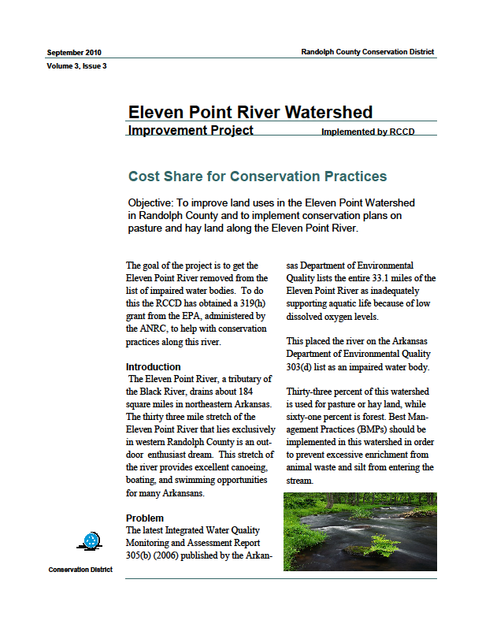
Task 4
Technology Transfer:
Develop and publish a quarterly newsletter
(4 Completed)
Distribute the newsletter to landowners who own 15 acres or more within the Eleven Point Watershed
Plan and hold yearly outreach meetings to inform landowners within the Eleven Point Watershed

Slide 12
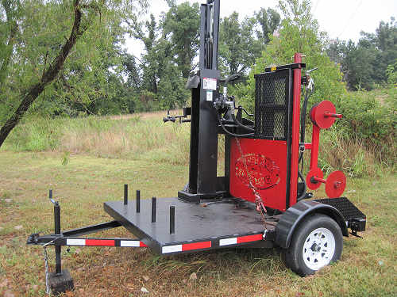
Task 5
Equipment Purchase
Purchase Fence Dawg fencing tool
Hold Field day to show producers how this equipment works

Slide 13
Task 6
Reporting:
Provide quarterly reports that include implementation documentation
Provide Annual Reports
Complete Final Report

Slide 14
Eleven Point River 319(h) Project
Accomplishments to date:
Held monthly Conservation District Board Meetings
Published 4 Newsletters
Completed 89 conservation plans
(on about 15,872 acres)
Purchased Fence Dawg Fencing Equipment
$26,134.70 has been paid to landowners
($53,591.92 landowner match)

Slide 15
Best Management Practices:
Ponds:
3 Completed
Critical Area Planting:
1.5 acres completed
Pipeline:
1,255 ft. installed

Slide 16
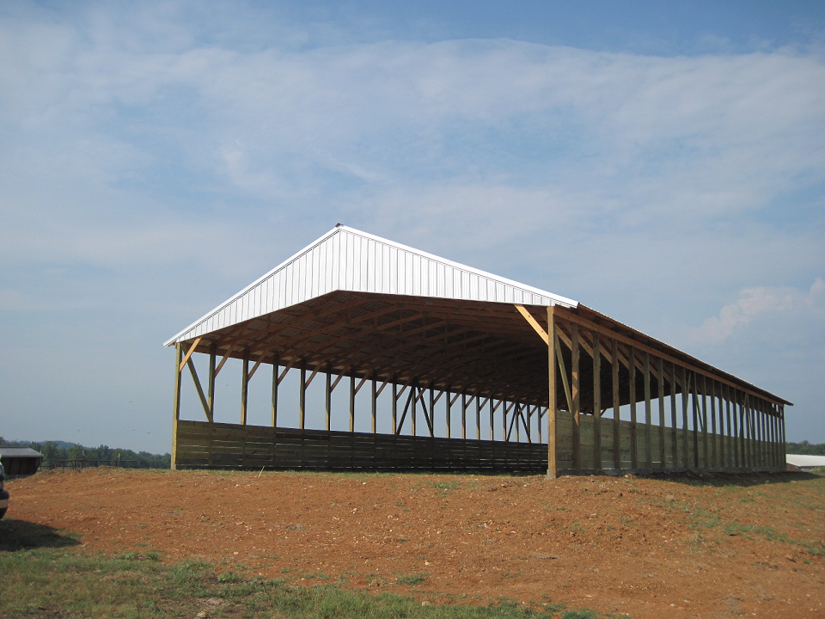
Best Management Practices:
Waste Storage Facilities
2 Completed

Slide 17
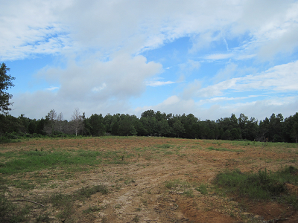
Best Management Practices:
Pasture and Hay Planting
166 acres completed

Slide 18
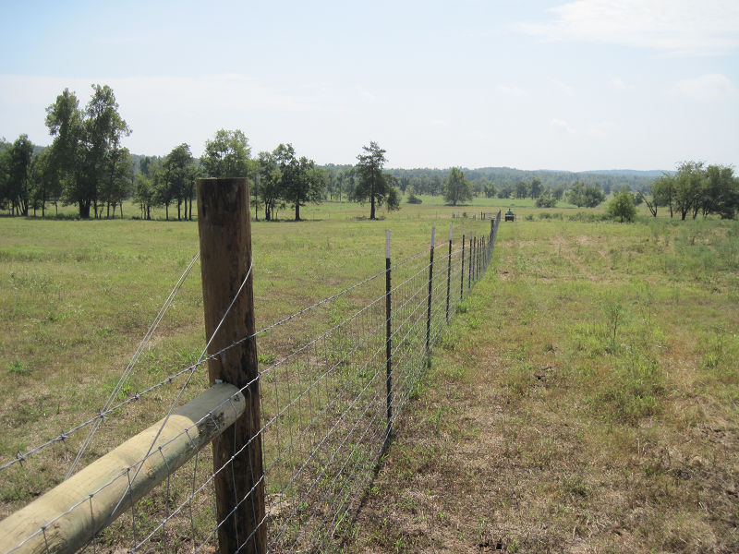
Best Management Practices: Fence
13,355 ft. completed

Slide 19
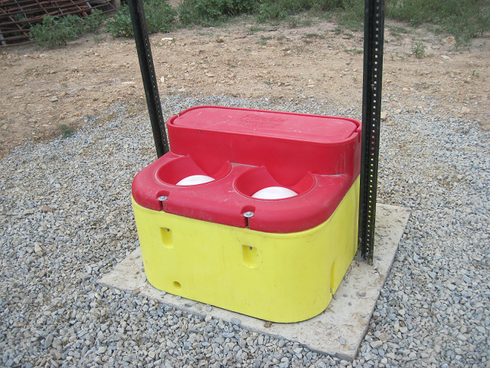
Best Management Practices:
Watering Facilities
3 Completed

Slide 20
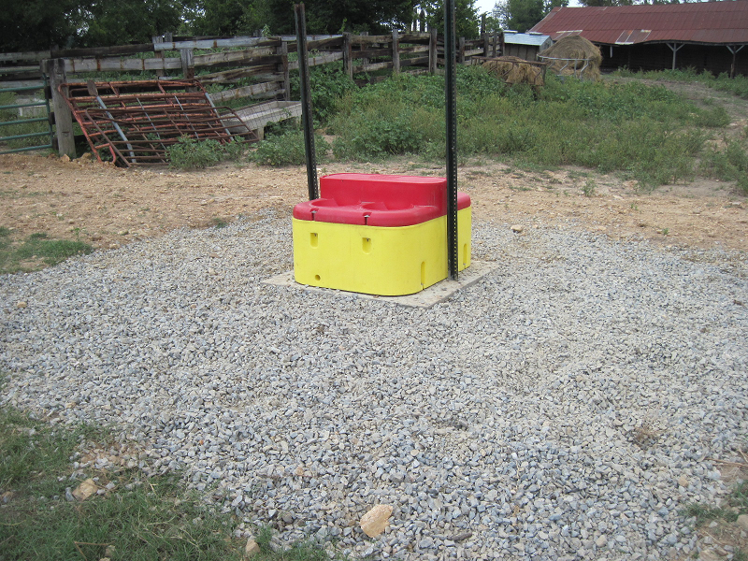
Best Management Practices:
Heavy Use Areas
Over 5,000 square ft. Installed

Slide 21
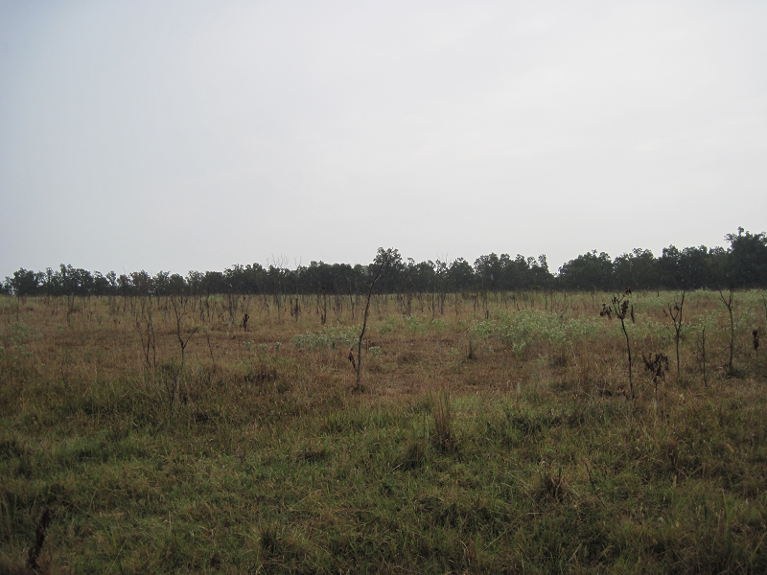
Best Management Practices:
Pest Management & Brush Management
211 acres of Pest Management completed
10 acres of Brush Management completed

Slide 22
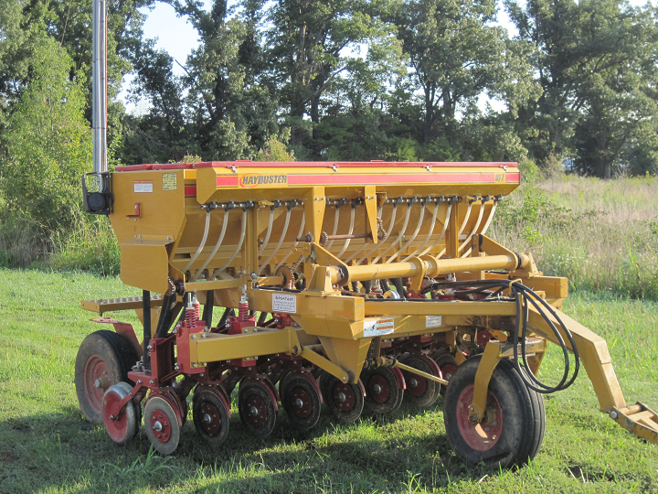
R.C.C.D. Equipment
Haybuster 107 No-till Drill

Slide 23
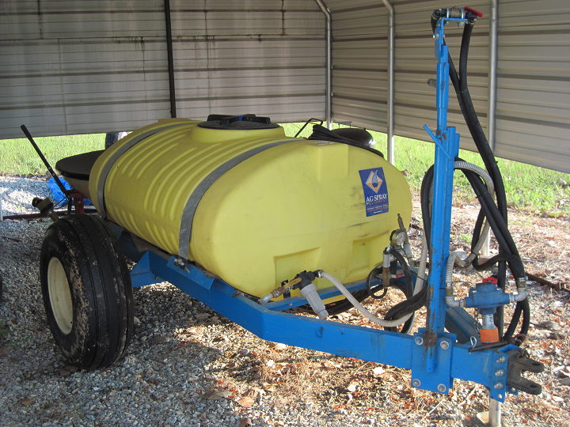
R.C.C.D. Equipment
300 gallon Trailer Sprayer

Slide 24
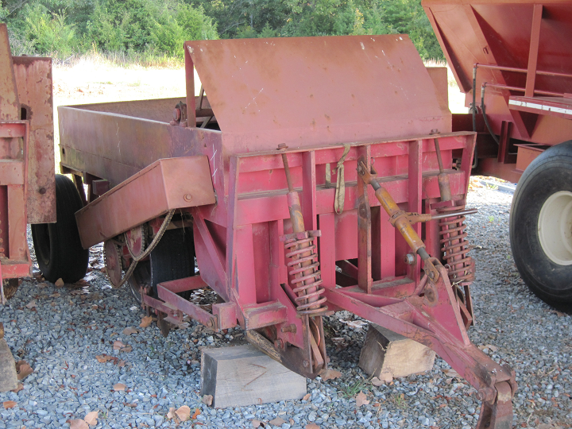
R.C.C.D. Equipment
2 Spriggers

Slide 25
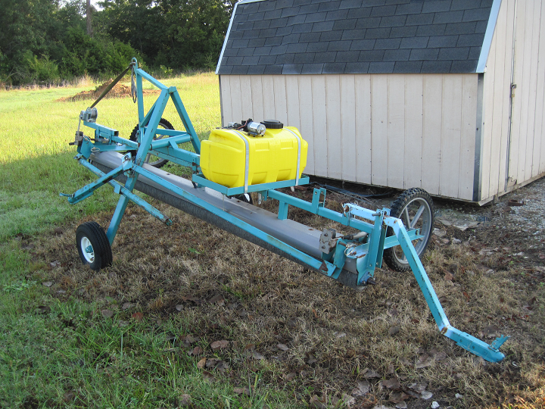
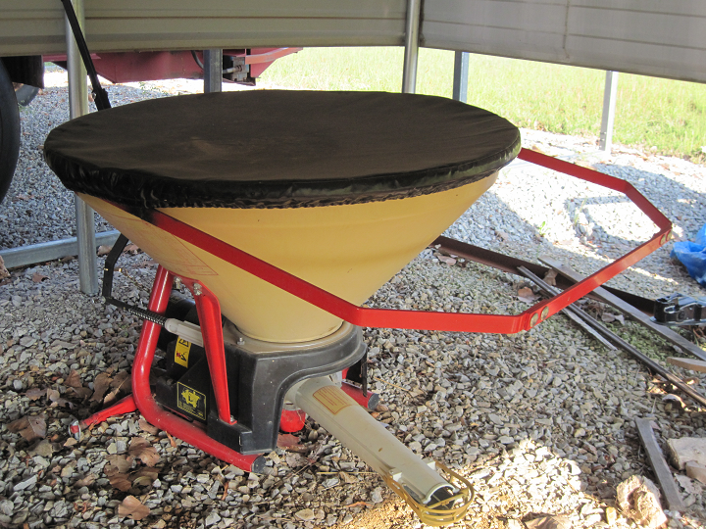
R.C.C.D. Equipment
Roto Wiper & Vicon Seeder

Slide 26
QUESTIONS???

